Slide 1
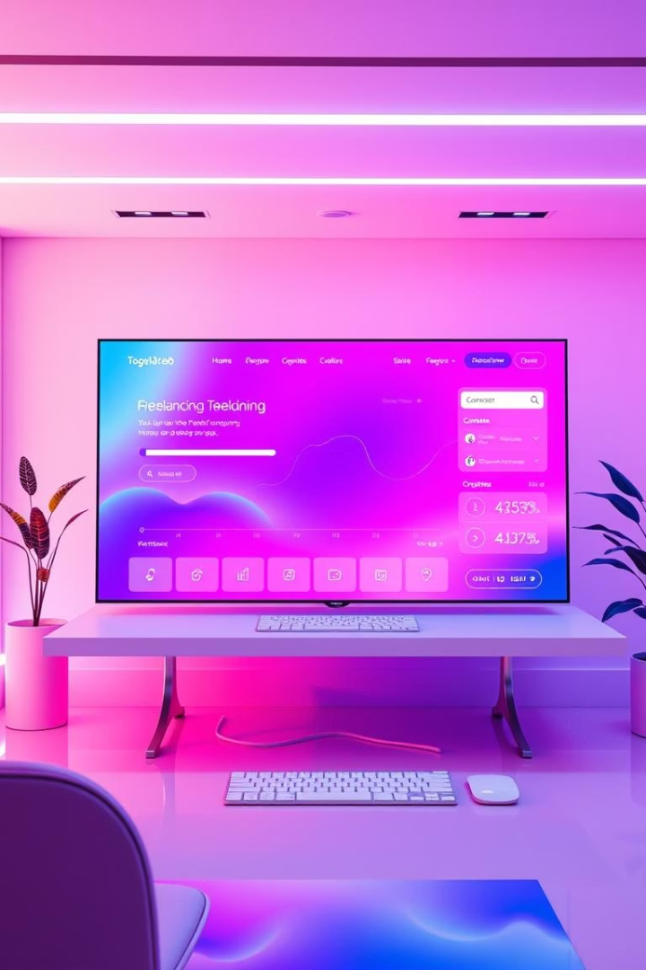

Institute of Computer Technology
Ganpat University
Gigster - A Marketplace for Freelancers
Connecting freelancers and clients for seamless project collaborations.
Name : Krish Patel
En no : 21162171023
Branch : B.tech CSE (CS)

Slide 2

Company Overview & Services
iConsultify Solutions LLP
Core Services
Custom Shopify & Web Development
Digital solutions provider based in Ahmedabad, founded 2018.
Mobile Apps & Digital Marketing SEO
UI/UX Design and IT Consultancy
Departments
Development, Design, Marketing
Sales and Client Relations
Quality Assurance

Slide 3

Project Purpose and Objectives
Purpose
Connect freelancers and clients with efficient digital platform.
Objectives
Bridge freelancers and clients
Simplify project management
User-friendly and secure platform

Slide 4
Key Features and Technology Stack
Features
Technology Stack
Freelancer Profiles & Service Listings
Frontend: HTML, CSS, JavaScript, React, Bootstrap
Messaging System & Order Management
Backend: Node.js, Express.js
Secure Payments & Review System
Database: MongoDB

Slide 5
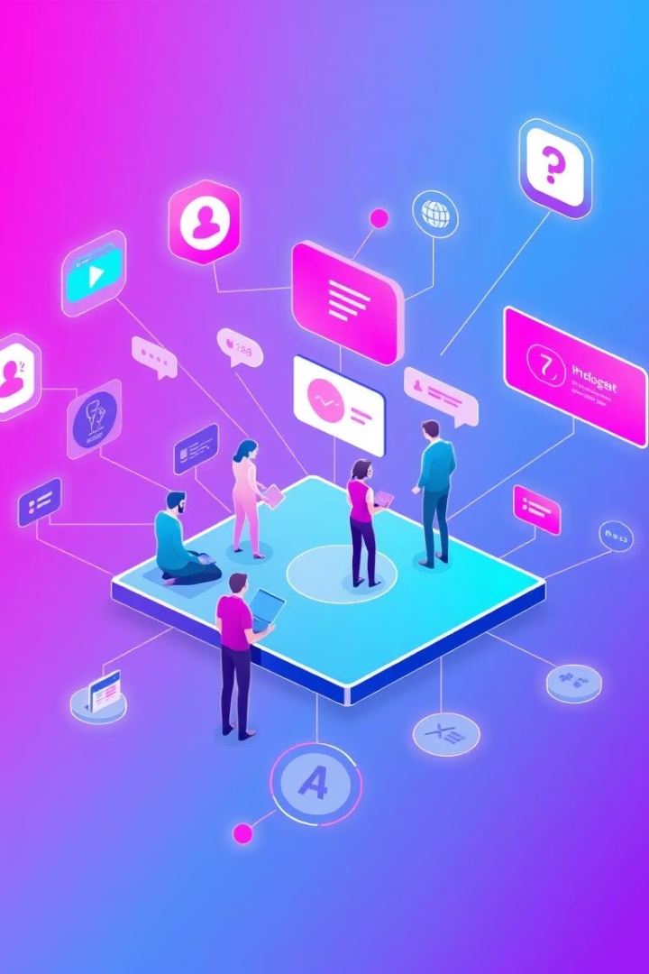



System Analysis and User Roles
Freelancers
Profiles, proposals, project tracking, invoicing.
Clients
Create projects, review proposals, communicate, track progress.
System Benefits
Transparent communication, secure transactions, centralized workflow.

Slide 6

Implementation Highlights
Admin Features
Backend Development
Activity logs, role-based redirection, upcoming booking integration.
Frontend Enhancements
Authentication, gig management APIs, secure OTP flows.
New gig pages, responsive design, improved UI/UX.

Slide 7
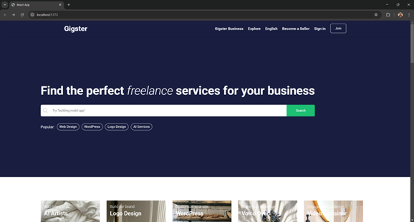
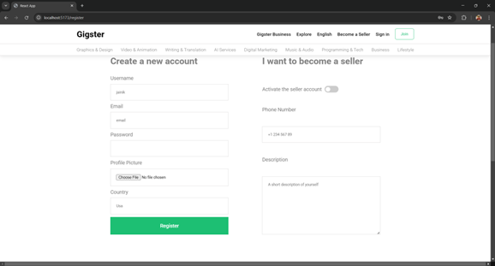
User Interface Screenshots
Home Page
Register Page

Slide 8
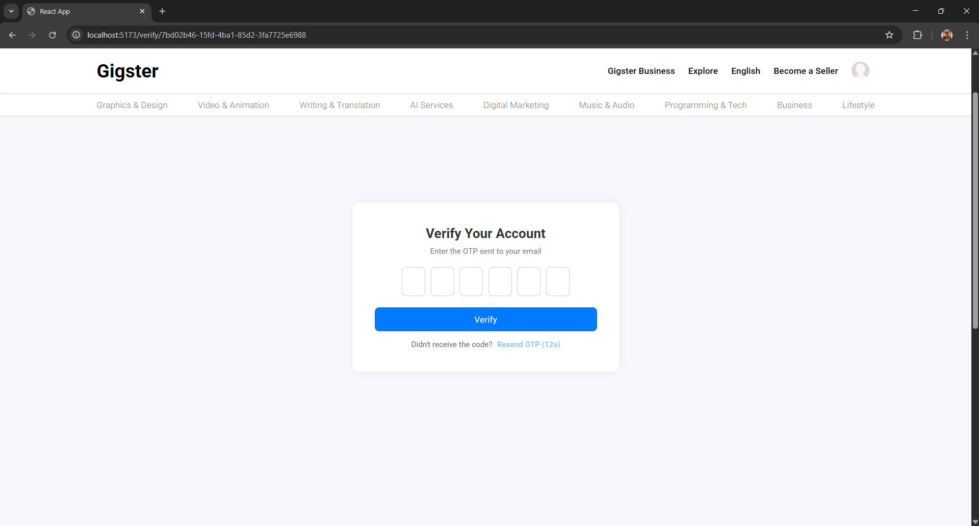
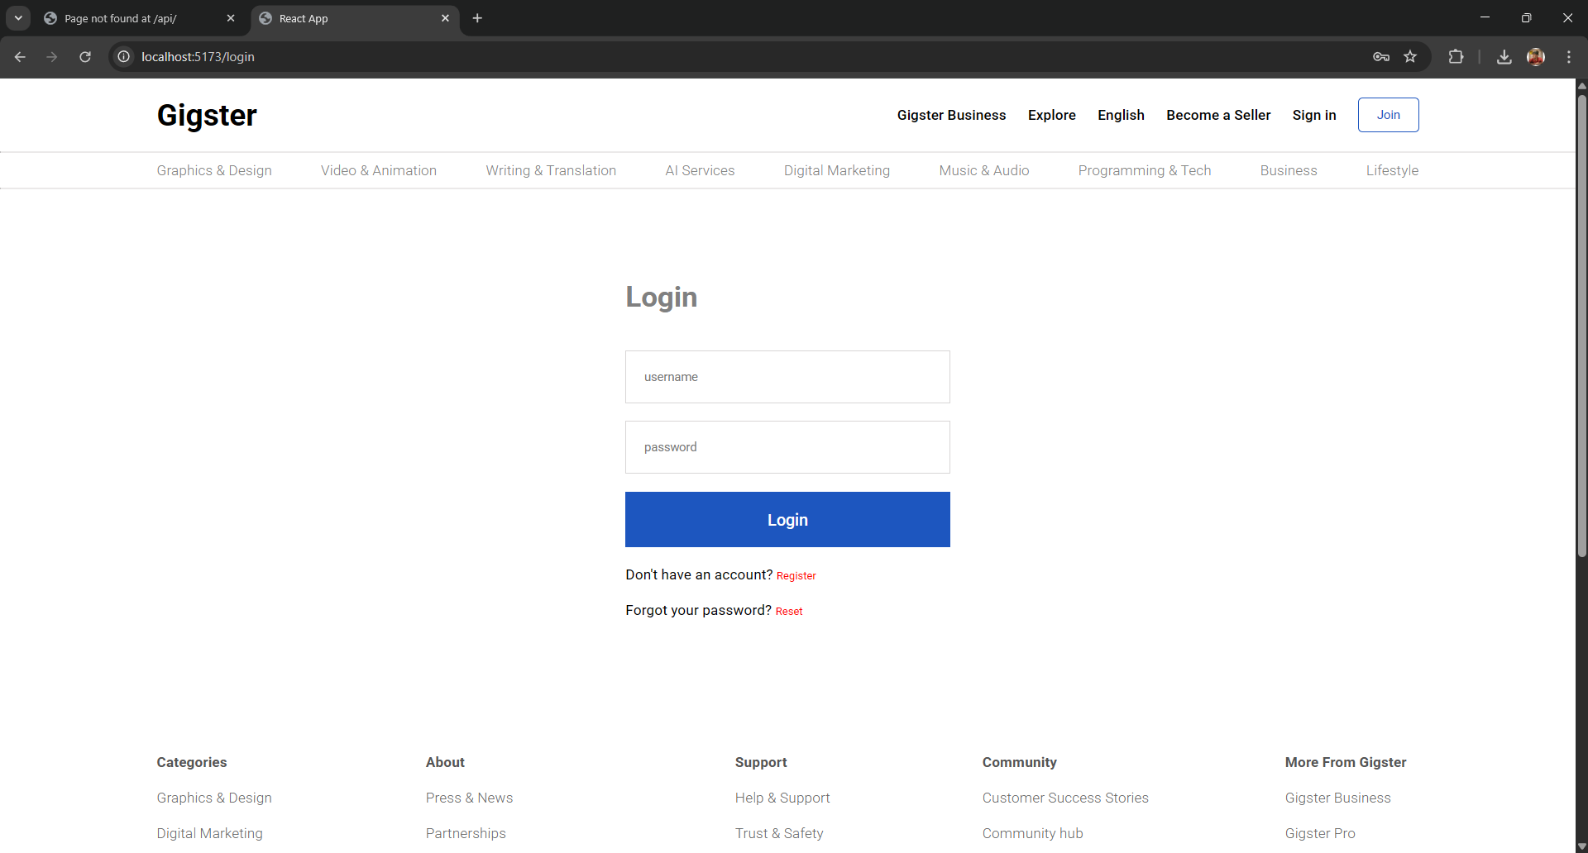
User Interface Screenshots
Account Activation page
Login Page

Slide 9
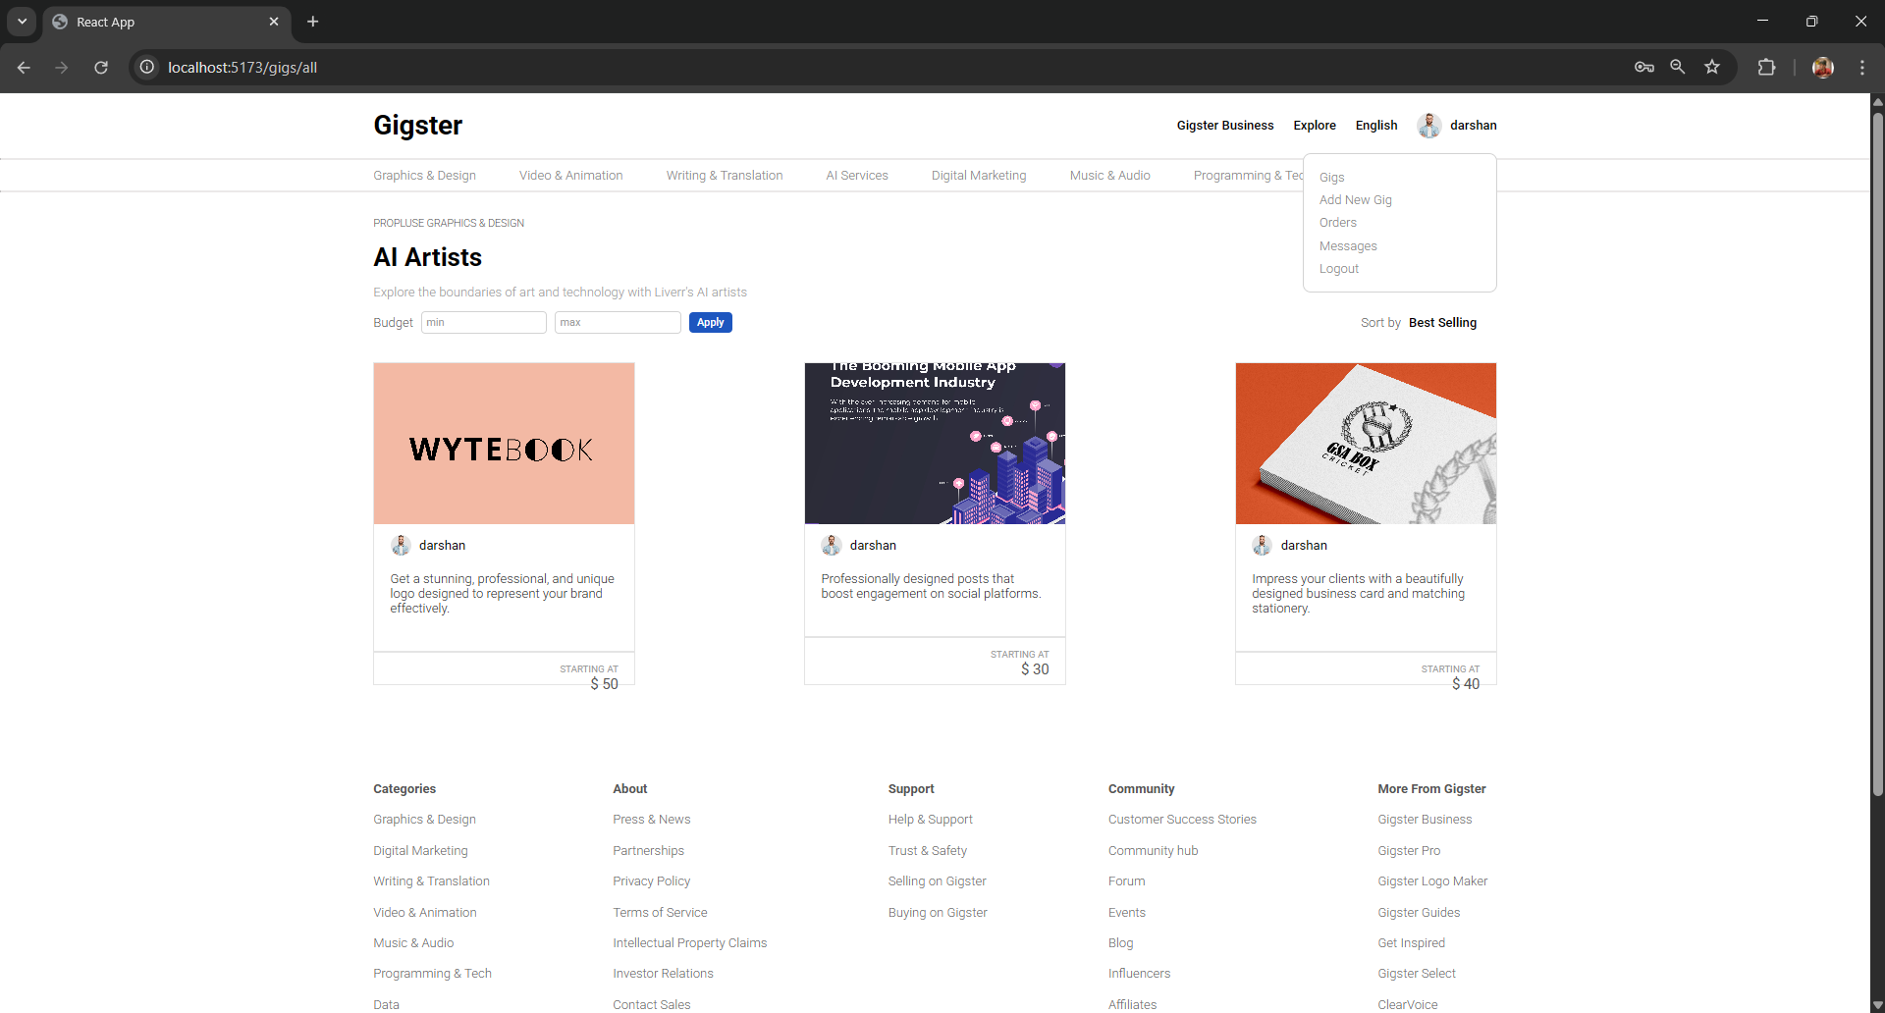
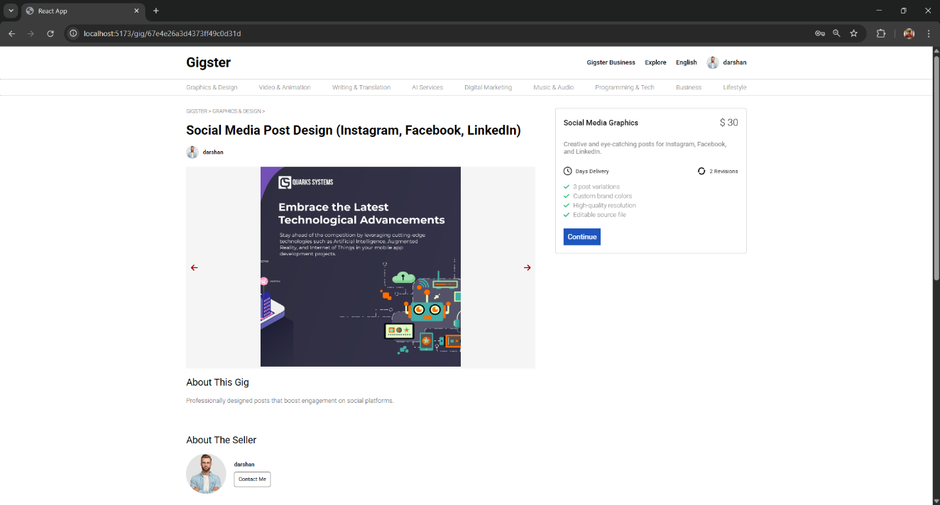
Listed Gig Page
Individual Gig detail Page

Slide 10

Conclusion and Future Work
Conclusion
Secure, responsive platform with core freelancing features operational.
Future Enhancements
Advanced messaging with real-time updates
Project booking and milestone tracking
Smart gig filters and dispute management
Notification center and analytics dashboard

Slide 11
Thank You

